Slide 1
Address Decoding
5.1-5.2
How to address memory and information on
DTACK* and BERR
Notes:
Connect BERR to CPLD, but will be left high.

Slide 2
The Basics
68000 has 24 address lines
Access in form of 16-bit words
Can also access individual bytes
Address lines A1 to A23
The two data strobes UDS and LDS comprise A0
Notes:
68000 has 16M of mappable memory (can be 16M locations of 8 bits or 8M locations of 16 bits)
Individual bytes can be accessed from address bus so UDS and LDS are unneeded

Slide 3
Purpose for Address Decoding
If we had a single memory component, we would be golden
Many devices’ internal storage varies
RAM/ROM/Peripherals
Notes:
Memory components are not nearly as large as 16M
Often RAM and ROM devices are needed for different uses
Single meaning ram and rom together, not specifically a 16 bit chip

Slide 4
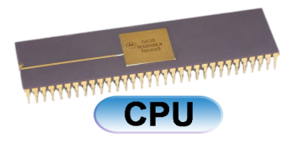
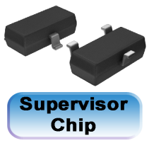
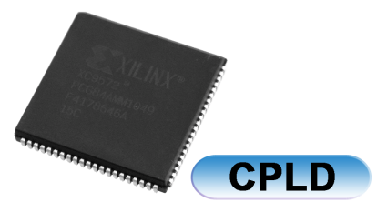
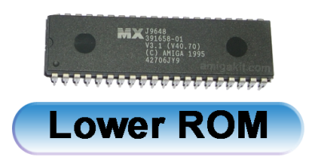
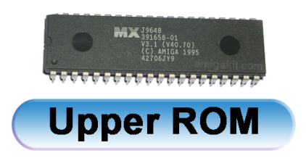
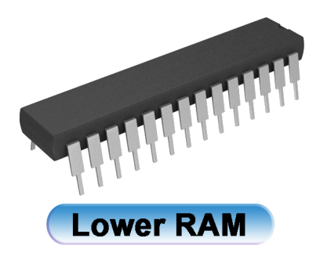
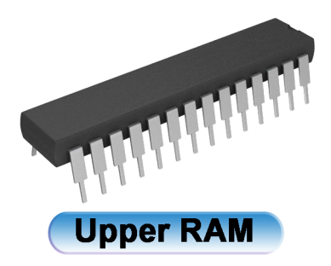
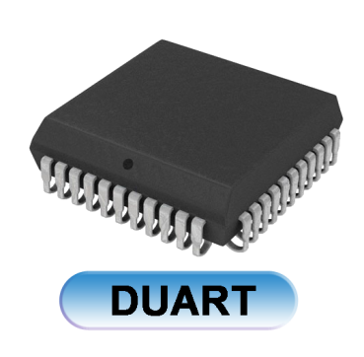
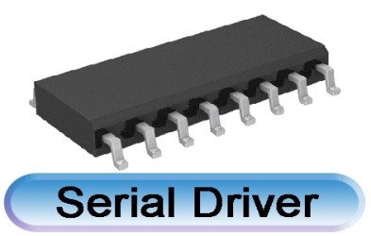
DTACK*, BERR, AS
A20,21-A23
D0-D7
A1-A12
D8-D15
A1-A12
D0-D7
A1-A13orA14
D8-D15
A1-A13orA14
D0-D7 only
A1-A4
Notes:
Add one more line from cpu and cpld (bidirectional) DTACK*, BERR, AS, interrupt ack, etc.
A20,A21-a23

Slide 5
Address Lines
There are only 12 address lines going into the ROM chips because of the specific type of chip
  Eg. A1-A18 would go into SST39SF040
The same reason applies to the RAM chips and the DUART
  Eg. A1-A14 would go into CY7C119CN

Slide 6
Types of Decoding
Full Address Decoding: Each addressable location within a memory component responds to a unique address.
Partial Address Decoding: Not all the address lines available take part in the decoding process.
Block Address Decoding: Compromise between partial and full
Notes:
-Full address decoding ensures that each address refers to a unique location.
-Need to discuss block decoding for completeness. Use of 3-8-line decoder is not understandable unless block decoding is discussed.

Slide 7
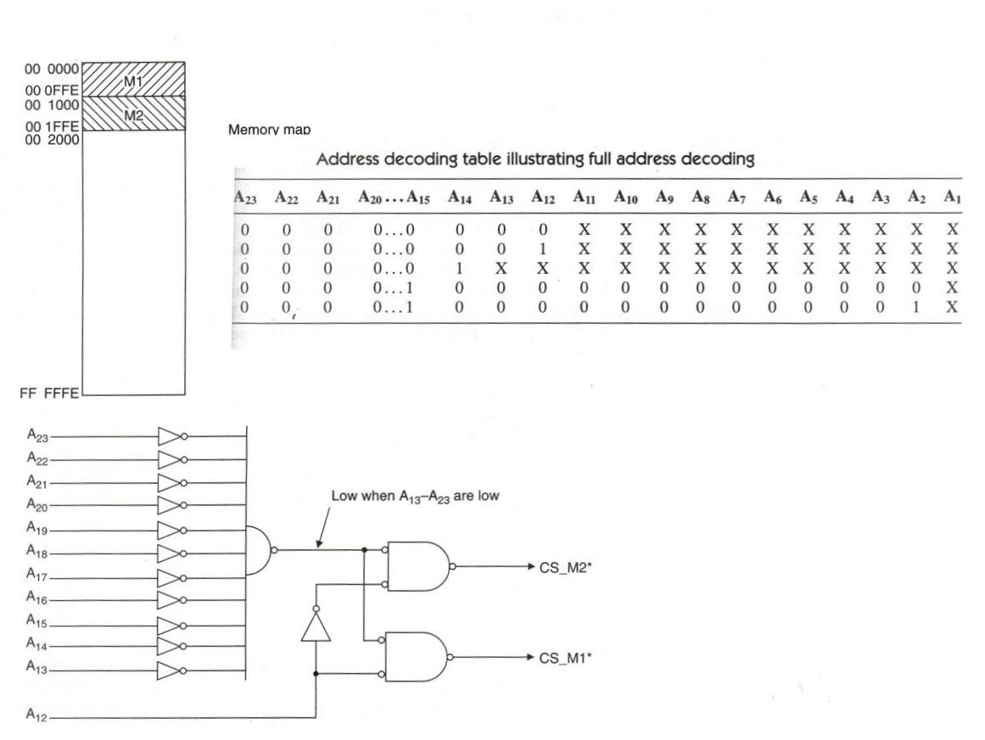
Full Address Decoding
Notes:
Example showing full address decoding for the hypothetical configuration in slide 4.

Slide 8
Decoding Issues
A copious amount of logic chips are needed to implement the decoding.
Solution: Partial Address Decoding
It is the simplest and least expensive.
Drawbacks: Prevents full use of the 68k memory space and makes it difficult expand the memory system.
Notes:
-A great deal of logic is required for full address decoding.
-Partial address decoding prevents full use of the memory space and makes it difficult to expand the memory system.

Slide 9
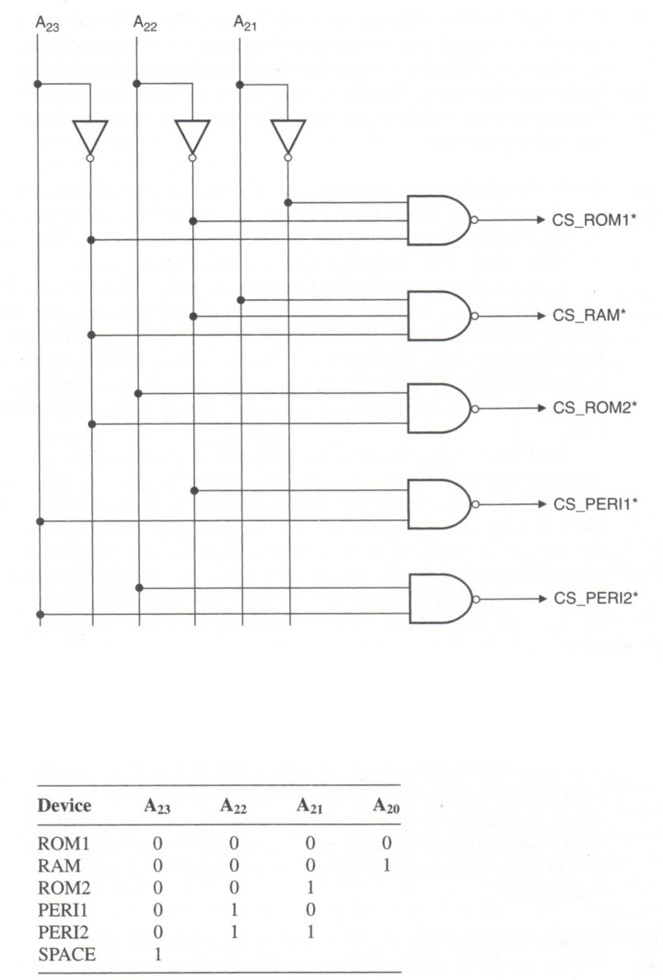
Partial Address Decoding Example with Peripherals
Notes:
Partial decoding example for the example given in the text in which 5 memory devices are connected to the 68k.

Slide 10
Synchronous Bus Control
Used to support older peripherals
VPA* - valid peripheral address
  When a peripheral with a synchronous interface is being accessed, it asserts the VPA* to indicate a synchronous bus cycle is being requested
VMA* - valid memory address
  Assertion of VMA* is CPU’s response to VPA*
  Indicates to peripheral that there is a valid address on the address bus
Notes:
Older method that 68k will support but will be unused on this project.
Check book for definition of older peripherals

Slide 11
Synchronous Bus Control
E – enable
Timing signal
Has no relationship with processor’s clock
Non-symmetric – low for 6 clock cycles, high for 4 clock cycles
Notes:
Purpose unknown.

Slide 12
Implementations of Addressing
PROM
FPGA
PLA
PAL
74LS138 – Used for block decoding
CPLD - XC9572 or XC95108 (Recommended)
Notes:
Use to access 328 decoder?

Slide 13
PROM
Programmable Read Only Memory
Nothing more then a look up table containing the address decoding table.
Very versatile but expensive and time consuming to program.
Notes:
-Effective for block addressing.
-Very versatile because it can select blocks of differing size and is very versatile.
-Disadvantages: anything over 8 address lines is expensive, takes a long time to program and is difficult to test.

Slide 14
FPGA and PAL
Field Programmable Gate Array
Can only be programmed once
Programmable Array Logic
Programmable AND and OR
Notes:
-FPGA has no logical OR capability on its outputs.

Slide 15
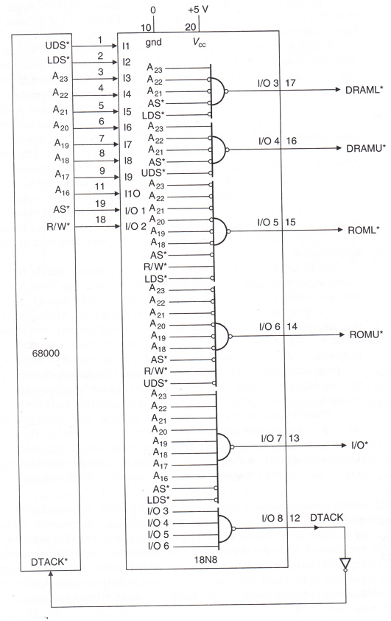
PAL

Slide 16
74LS138
3 line input
8 active low output
Simple
Cheap
Notes:
-Decoders are used to carry out block addressing

Slide 17
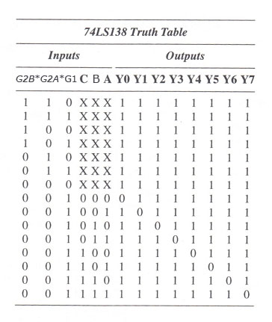
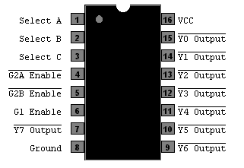
74LS138
3-line-to-8-line Decoder
Notes:
-A, B, C are active high inputs.
-G2A, G2B, G1 are enable inputs that allow the range of mapped addresses to be changed.
-Access is to the output that is zero
-notice that G2A, G2B must be low and G1 high to get an output of zero

Slide 18
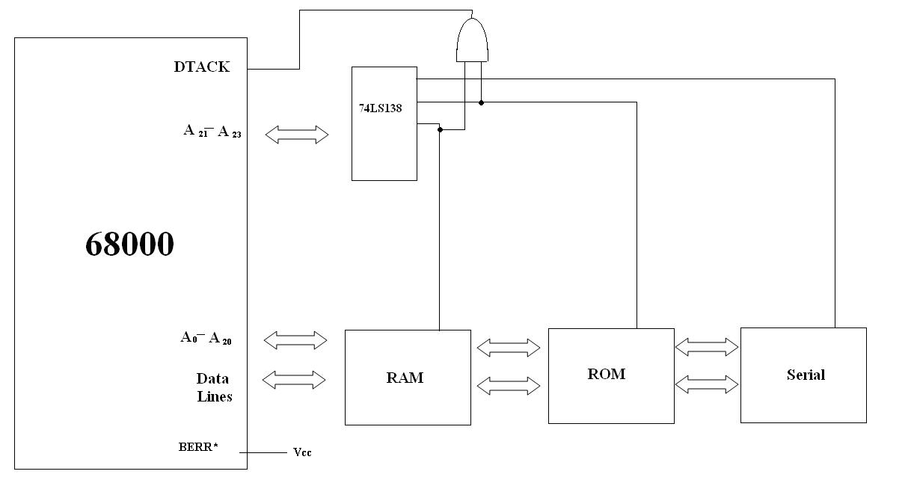
74LS138 Layout
*
CE*
CE*
CS*

Slide 19
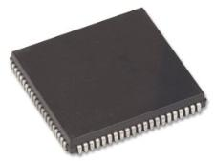
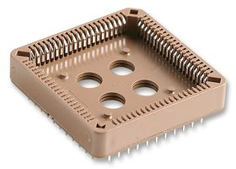
CPLD
Input the address lines
Output device selection (chip select)
More initial expense
Can reduce design and debug time
Will encompass other Glue Logic

Slide 20
More on CPLD
Can be used for de-bouncing
Handles UDS and LDS
Can be used to output to test LEDs
Could also be used for adding fancy light shows or to control fan speed in conjunction with a temperature ic

Slide 21
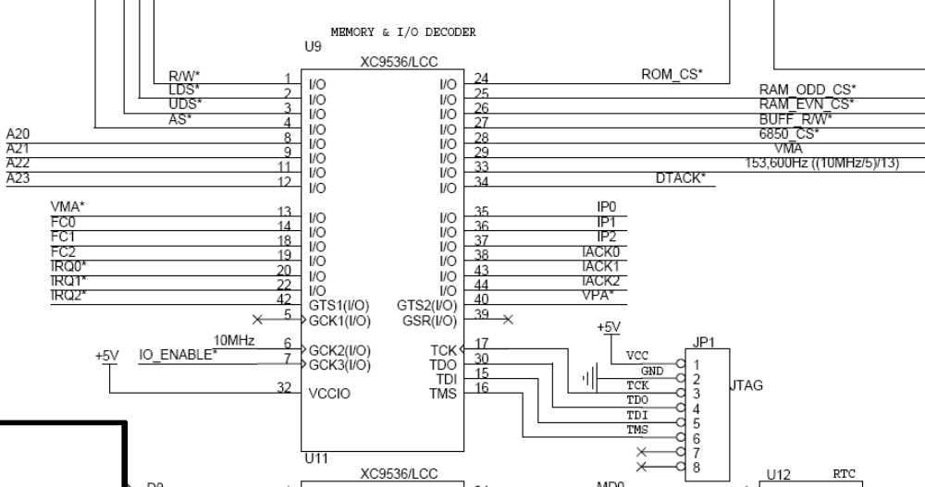
CPLD
Taken from Wichit Sirichote’s design
http://chaokhun.kmitl.ac.th/~kswichit/68k/68k.html
Notes:
Example of CPLD use to do address decoding and to handle the DTACK and BERR lines.

Slide 22
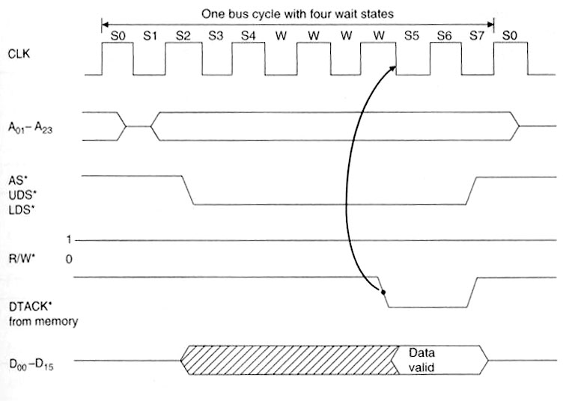
Read Cycle
Notes:
Get more from textbook, assume to wait 3 cycles

Slide 23
Memory & Peripheral Interface
DTACK* - data transfer acknowledge
Indicates that the contents of the data bus are valid
When asserted, 68000 completes the current access & begins next cycle
If not asserted, processor idles until DTACK* goes low or an error state is declared
Used for asynchronous bus control
Notes:
-Any address decoding system must set DTACK low when the data transfer is complete.

Slide 24
-- DTACK Control code for the processor
--DTACK of Processor -- needs to pulse based on AS (p.225 in book)
-- after AS goes low, from being high count down, then Dtack low
-- otherwise if AS is high Dtack is high
-- DTack goes high when UDS/LDS both go high.
process( CLK )
begin
if(rising_edge(CLK) ) then
-- if ( ADDRESS_sig /= "010" ) then
if ( AS_sig = '0' and AS_sig /= AS_Tempsig ) then
timer <= "10";
DTACK_sig <= '1';
end if;
AS_Tempsig <= AS_sig;
if (timer /= "00") then
timer <= timer - 1;
end if;
if (timer = "00" and AS_sig = '0') then
DTACK_sig <= '0';
end if;
if ( UDS_sig = '1' and LDS_sig = '1' and AS_sig = '1' and DTACK_sig = '0') then
DTACK_sig <= '1';
end if;
-- end if;
end if;
end process;

Slide 25
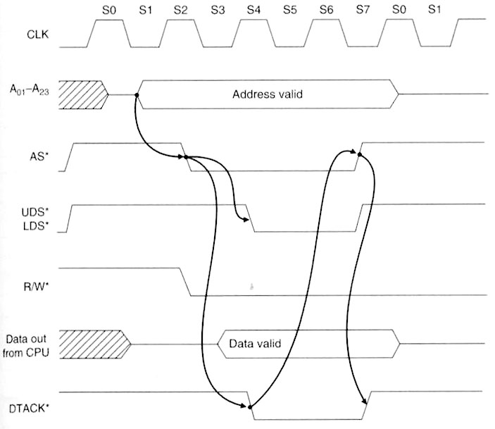
Write Cycle
Valid Address is sent
AS* negates when finished
Address Strobe line is asserted
An entire word is to be written
DTACK is signaled by AS*
DTACK negates with AS*

Slide 26
Special Function Pins –
Bus Error Control
  BERR* - bus error input
  Typical applications are:
    Illegal memory access
    Faulty memory access
    Failure to assert VPA
    Memory privilege violation
  Used for asynchronous bus control
Notes:
-Address decoding system must set BERR low if there is an error such as listed.
We won’t be using it.

Slide 27
Pricing
On Board Logic
  74LS74 x 2
    Digikey: .52 each = 1.04
    Jameco: .36 each = .72
  74LS161 x 2
    Digikey: .76 each = 1.52
    Jameco: .55 each = 1.10
  74LS138
    Digikey: .72
    Jameco: .52
  Minor logic gates
Extra soldering and design
Less Flexible
Notes:
7474 is a dual d-type flip flop
74161 is a 4 bit synchronous counter
74138 is a 3-8 line decoder

Slide 28
Pricing
CPLD
  Chip: XC95108-15PC84I
    Ebay: ~$15
  JTAG Programming Cable
Encompasses all address and I/O decoding
Dynamic board design

